Slide 1
Arunachal Pradesh

Slide 2
arunachal pradesh
Arunachal Pradesh is a state in Northeastern India. It became a state on 20 February 1987. It borders the states of Assam and Nagaland to the south. It shares international borders with Bhutan in the west, Myanmar in the east, Itanagar is the state capital of Arunachal Pradesh. Arunachal Pradesh shares a 1,129 km border with China's Tibet Autonomous Region.

Slide 3
Location
Arunachal Pradesh is located between 26.28° N and 29.30° N latitude and 91.20° E and 97.30° E longitude and has an area of 83,743 km² (32,333 sq mi).

Slide 4
climate of arunachal pradesh
The climate of Arunachal Pradesh varies with elevation. The low-altitude areas have a humid climate. High-altitude areas (3500–5500 m) have a highland climate . Arunachal Pradesh receives 2,000 to 5,000 millimetres (79 to 197 in) of rainfall annually, 70%–80% obtained between May and October.

Slide 5
Districts
Arunachal Pradesh comprises two divisions, namely, East and West, each headed by a divisional commissioner and twenty-five districts, each administered by a deputy commissioner. Arunachal Pradesh has a total of 25 districts, West Siang being the largest district in terms of area and Tawang being the smallest district. Papum is the largest district in terms of population and Diwang Valley is the smallest district.

Slide 6
Population
Arunachal Pradesh population in 2022 is (1.53 Millions)

Slide 7

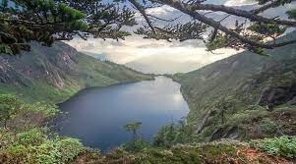
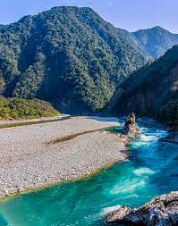

Slide 8
Architecture of Arunachal Pradesh
Architecture of Arunachal Pradesh . People make houses out of Bamboo , wood and etc. These type of houses are mostly rectangular in shape with mostly three or more rooms. The plans and sizes vary as per requirement with linear planning , rooms opening into one another. Typical layout of house consists of a Sora Ghar , Huwa Ghar , Randhani Ghar.

Slide 9
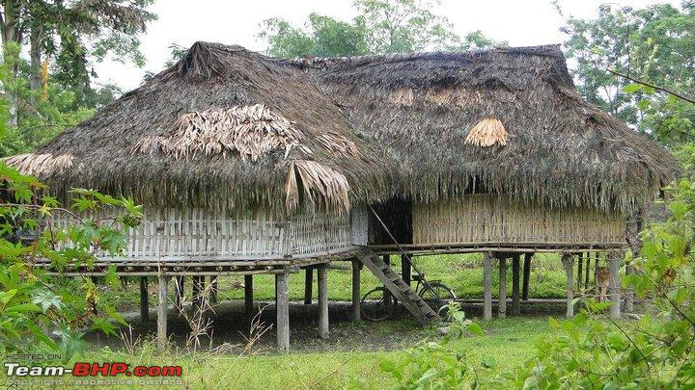
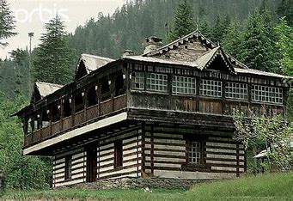
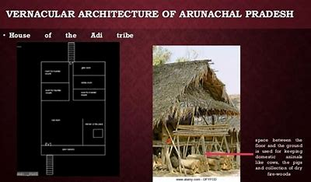
Example houses

Slide 10
how scientificlly the architecture of arunachal Pradesh was built during the ancient period
Their villages are often situated near rivers and the site with a considerable height on the spur of the hills. The houses are made of wood , bamboo.

Slide 11
the end
A presentation by Group 5

